Slide 1

SQL Server 2005
Tracing and Profiling
C3: Protected

Slide 2

About the Author
Created By: | Mahua Saha (103924)
Credential Information: | 9+ years SysAdmin / DBA experience
Version and Date: | V 1.0 26-March-2008
Cognizant Certified Official Curriculum

Slide 3









Icons Used
Hands on Exercise
Questions
Tools
Coding Standards
Test Your Understanding
Reference
A Welcome Break
Contacts
Demonstration

Slide 4

SQL Server Profiler : Overview
Introduction:
Microsoft SQL Server Profiler is a graphical user interface to SQL Trace for monitoring an instance of the SQL Server Database Engine or Analysis Services. One can capture and save data about each event to a file or table to analyze later. One can manually analyze the trace file/table or use Database Engine Tuning Advisor to give recommendations based on the current trace file.

Slide 5

SQL Server Profiler: Objectives
Objective:
  Understand the function of SQL Profiler
  Understand the terms that describe the way SQL Profiler functions
  Learn how to use SQL Profiler
  Capture important properties and events for a trace file
  Analyze the trace file
  Replay a trace file
  Understand the function of Database Engine Tuning Advisor
  Mechanism to do manual tracing

Slide 6
SQL Server Profiler: An Introduction
Microsoft SQL Server Profiler is a graphical user interface to SQL Trace for monitoring an instance of the SQL Server Database Engine or Analysis Services. You can capture and save data about each event to a file or table to analyze later. For example, you can monitor a production environment to see which stored procedures are affecting performance by executing too slowly.
Default location: SQL Profiler, if installed in the default location, can be found under Start\Programs\Microsoft SQL Server\Profiler.
NOTE: To run a trace, the user must have administrator rights on the SQL server being monitored.
NOTE: It's also a good idea to run Profiler on a client machine, instead of, on the SQL Server itself. If you do decide to store the Profiler data in a SQL Server table, don't store it in a database on the same server you are profiling, Instead, store the trace in a database on another SQL Server that you have created especially for this purpose.

Slide 7
SQL Server Profiler Terminology
To use SQL Server Profiler, you need to understand the terms that describe the way the tool functions.
Event: An event is an action generated within an instance of SQL Server Database Engine.
Event Class: An event class is a type of event that can be traced. The event class contains all of the data that can be reported by an event.
Event Category: An event category defines the way events are grouped within SQL Server Profiler. For example, all lock events classes are grouped within the Locks event category.
Data Column: A data column is an attribute of an event classes captured in the trace.
Template: A template defines the default configuration for a trace.
Trace: A trace captures data based on selected event classes, data columns, and filters.
Filter: When you create a trace or template, you can define criteria to filter the data collected by the event.
Notes:
Event
An event is an action generated within an instance of SQL Server Database Engine. Examples of these are: Login connections, failures, and disconnections.
Transact-SQL SELECT, INSERT, UPDATE, and DELETE statements.
Remote procedure call (RPC) batch status.
The start or end of a stored procedure.
The start or end of statements within stored procedures.
The start or end of an SQL batch.
An error written to the SQL Server error log.
A lock acquired or released on a database object.
An opened cursor.
Security permission checks.
All of the data generated by an event is displayed in the trace in a single row. This row is intersected by data columns that describe the event in detail.
Event Class: Examples of event classes are the following:
SQL:BatchCompleted
Audit Login
Audit Logout
Lock:Acquired
Lock:Released

Slide 8
Using SQL Server Profiler
Run Profiler during the load test, and analyze the Profiler output at the end of the load test to:
  identify the longest running queries
  most CPU intensive queries
  stored procedure recompilations
  errors like deadlocks
You can also use a specific trace template, that captures all the data you need for analysis.
After launching SQL Profiler, select the server that you want to monitor and then enter your login information.
After a connection has been established, the Trace properties dialog box will open. This dialog box has four tabs: General, Events, Data Columns, and Filters, which are used to specify the trace properties.

Slide 9
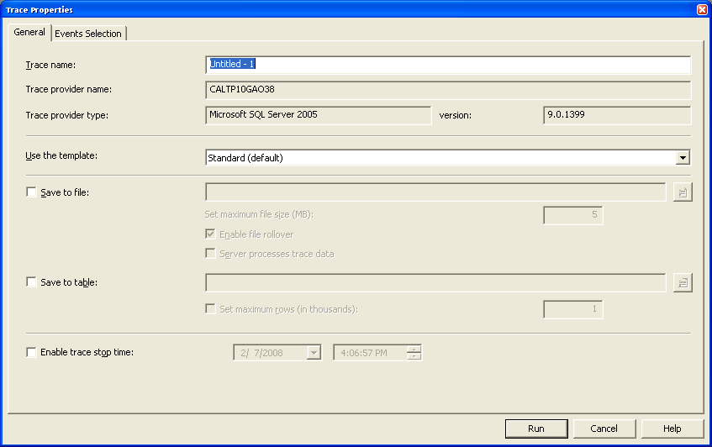
Trace Properties – General Tab

Slide 10
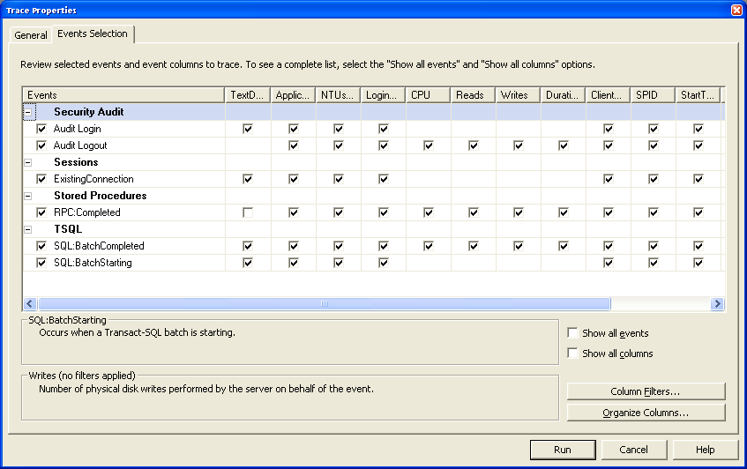
Trace Properties – Event Selection

Slide 11
Trace Properties :General and Event Tab
General Tab:
On the General tab, you specify the name of a trace, specify a trace template, and choose to save the data to a trace file or a SQL table.
Events tab:
On the Events tab, you can select the events to monitor. Some of the events that we typically capture are:
Stored Procedures: SP:StmtCompleted, SP:Completed, RPC:Completed and TSQL: SQL:StmtCompleted, SQL:Batch­Completed
Stored Procedures: SP:Starting, SP:StmtStarting and TSQL: SQL:StmtStarting
Sessions: Existing Connection
With this event you can verify the SQL Server options set for database connections.
Notes:
If you choose to save to a file, you have to specify a directory and filename; if you choose to save the data to a SQL server, you need to specify the server, database, and table.
Stored Procedures: SP:StmtCompleted, SP:Completed, RPC:Completed and TSQL: SQL:StmtCompleted, SQL:Batch­Completed
These events are triggered whenever a statement, stored procedure, RPC or batch is completed. By including the text, reads, CPU, and duration data columns in the trace, you can identify the slow running code and the cost in terms of CPU resources used. It is valuable to know the reads incurred for establishing a baseline against which you can compare optimization efforts.
Stored Procedures: SP:Starting, SP:StmtStarting and TSQL: SQL:StmtStarting
By including these events with the completed events, you can profile a stored procedure down to the line of code. This is useful for long-running stored procedures because it lets you identify the problematic statement before the completion. Additionally, if errors occur while running the stored procedures, you can pinpoint the statement at which an error is occurring.
Sessions: Existing Connection
With this event you can verify the SQL Server options set for database connections. Session options can affect the way queries are processed. For example, to use indexed views, the ARITHABORT option must be set to ON, otherwise the underlying table will be used to retrieve data instead of the clustered index on the view.

Slide 12
Trace Properties: Event Tab
Stored Procedures: SP:Recompile
By including this event in your trace, you can gauge the amount of recompiling and identify the code that needs to be optimized by including the SP: Starting event in the same trace.
Lock: Timeout and Lock: Deadlock
A lock timeout or a deadlock can equate to incomplete transactions and result in errors on the client side.
Errors and Warnings: Attention
This event is generated any time there is a disconnect by a client or a timeout.
Notes:
Stored Procedures: SP:Recompile
The steps involved in running a stored procedure are parsing, compiling, and executing. Each of these steps takes a finite amount of time. Ideally, code should be parsed and compiled only once, utilizing only the server resources to execute the query. Improperly coded stored procedures can cause a recompile every time they are called, which has an adverse effect on the duration and even can cause blocking. By including this event in your trace, you can gauge the amount of recompiling and identify the code that needs to be optimized by including the SP: Starting event in the same trace.
Lock: Timeout and Lock: Deadlock
You must track this event because it directly affects scalability of the application. A lock timeout or a deadlock can equate to incomplete transactions and result in errors on the client side.
Errors and Warnings: Attention
This event is generated any time there is a disconnect by a client or a timeout. For applications that typically require a significant amount of time to process, you may need to increase the timeout value to reduce the number of time­outs. For example, in ADO.NET you may need to increase the value of the CommandTimeOut property to more than 30 seconds (default) for queries that have long durations.
Errors and Warnings: Missing Column Statistics
SQL Server can automatically create and maintain statistics on tables and indexes. This information is merely a distribution of the values in particular data columns of the tables or indexes and is used by the query processor to select an execution plan. Missing or outdated statistics could cause the query processor to pick an inefficient execution plan, which can have an impact on the overall throughput of the application.

Slide 13
Trace Properties: Event Tab
Errors and Warnings: Missing Column Statistics
Missing or outdated statistics could cause the query processor to pick an inefficient execution plan, which can have an impact on the overall throughput of the application.
Errors and Warnings: Missing Join Predicate
This event is triggered whenever a cross join is run. Cross joins are very rarely used and could be a potential oversight in a developer’s code. Tracking this event will let you confirm whether queries reference tables in such a manner.
Errors and Warnings: Exception and Error Log
These events are useful for determining if any unusual errors are occurring as a result of stressing the application.
Notes:
Errors and Warnings: Exception and Error Log
These events are useful for determining if any unusual errors are occurring as a result of stressing the application. By monitoring this event you can establish whether these errors are a result of load. You can, for example, set the trace flag 1204 and 3605 for all connections made to a server, and SQL Profiler can capture information relating to deadlocks. Deadlocking is a serious problem that will result in a poor client experience and significantly affect your application throughput.

Slide 14
Trace Properties: Data Column
Data Column:
On the Data Columns tab, you can specify the data columns that you want to capture. There are 43 columns, of which Event Class and SPID are required.
Some of the data columns that we normally collect are listed as below
Event: The name of the event. For example, the start of a stored procedure, a connection established, and so on.
Text: The text of the SQL command being run. This column can be blank if it is irrelevant for a particular event.
CPU: CPU resources used in milliseconds.
Reads: Number of logical reads performed to execute a query.
Writes: Number of physical writes performed by a SQL command.
Duration: The duration of an event, such as the time to execute a stored procedure.

Slide 15
Trace Properties: Data Column
StartTime: Time the event was triggered
EndTime: Time the event completed. This applies to end events.
NestLevel: The depth within a nesting operation. For example, if a stored procedure calls another stored procedure, the nest level of the calling procedure is 1 and that of the called procedure is 2. This is equal to the @@NestValue global variable.
Application Name: The name of the application that has a connection to the server.
HostName: The machine name on which the application that submits a SQL command is running.
NTUserName: The Windows user that the connecting application is running under.
LoginName: Either the Windows user name or the SQL server login, depending on the authentication method used to connect.

Slide 16
Trace Properties: Filters
Filters:
On the Filters tab, you can specify filters to further limit the data collected. For example, if you are only interested in the SQL activity generated by one particular application, you can set a filter on the application name.

Slide 17
Analyzing the trace
Locating Deadlock Causes: If you have captured the events like Lock:Deadlock and Lock:Deadlock Chain events, SQL Profiler will produce a trace that contains details on the deadlocks on your server. Record whatever identifying information you want - for example, the application name, logon name, and so on - and you'll be well on your way to figure out where the culprits are.
Auditing Logins: How about tracking the user activity on your SQL Server? Set up a trace that monitors the Security Audit:Audit Login and Security Audit:Audit Logout events, and send it to a trace table. Then you'll have a persistent record right in your database of who was using the database and when they were using it.
Watching for Table Scans:
Another good use of SQL Profiler is to find queries that are causing table scans on your server. To check, turn on a trace with the MISC:Execution Plan event. This will capture the query execution plan for every query. Then look over these plans for any that include a "Table Scan" or "Clustered Index Scan“. You can then examine those particular queries in more detail to see whether adding additional indexes to your database's tables could make them more efficient in the future.

Slide 18
Analyzing the trace (contd.)
To find the query causing blocking, double click on the “Blocking” SPID to see the Query being executed at that time. Execute “sp_who2”. You could also additionally start the SQL Profiler Trace to capture the events. Note the SPID of the Blocking processes and Blocked Processes (or screenshot).
Execute Query to find out the “Blocker” (if GUI is not there):
  IF EXISTS
  (SELECT * FROM master.dbo.sysprocesses
  WHERE spid IN (SELECT blocked FROM master.dbo.sysprocesses))
  SELECT spid, status, loginame=SUBSTRING(loginame,1,12),
  hostname=substring(hostname, 1, 12),
  blk=CONVERT(char(3), blocked),
  dbname=SUBSTRING(DB_NAME(dbid), 1, 10), cmd, waittype
  FROM master.dbo.sysprocesses
  WHERE spid IN (SELECT blocked FROM master.dbo.sysprocesses)
  AND blocked=0
  ELSE
  SELECT 'No blocking processes found!'

Slide 19
Analyzing the trace (contd.)
You can directly query a trace file by using a system function called fn_trace_gettable. For example, the following query returns all events with greater than 1000 milliseconds duration from trace.trc file in a table format:
SELECT * FROM ::fn_trace_gettable (‘c:\trace.trc’, default) WHERE Duration > 1000
We consider any code that has a duration of a second or more while the application is under minimal load to be an area for further investigation and potential improvement.
Find out the long running queries and stored procedures, what are the most CPU intensive stored procedures, which stored procedures are being recompiled too many times, are there any errors that are being generated due to stress etc.
You can present the trace file to Database Engine Tuning Advisor to give recommendations on creating and dropping indexes or statistics. But you have do this activity with several trace files generated at different time to get an exact idea of creating which indexes will at all be helpful.

Slide 20
Database Engine Tuning Advisor
DTA is a tool that analyzes performance of workloads run against a database
A workload is a set of T-SQL statements that are executed against a database
DTA analyzes the performance and gives recommendation for physical design structures. These could be recommendations to add, remove or modify clustered and non-clustered indexes, indexed views and recommendations on partitioning
DTA can be run using
  Graphical Interface
    Select Database Engine Tuning Advisor option from Tools menu in SSMS
  Command-line utility dta.exe
    E.g. dta –S MyServer –E -D tpcd1G -if tpcd_22.sql -F –of script.sql –A 0 -m 5 -fa IDX_IV
Notes:
-S – server name
-E – trusted connection
-D – database
-if – workload file
-of – output file
-F – option to overwrite existing output file
-A – tuning time in minutes (by default it is 8 hours; 0 – unlimited tuning time– recommended option)
-m – minimum improvement in percentage
-fa – structures to add
IDX_IV – indexes and indexed views

Slide 21
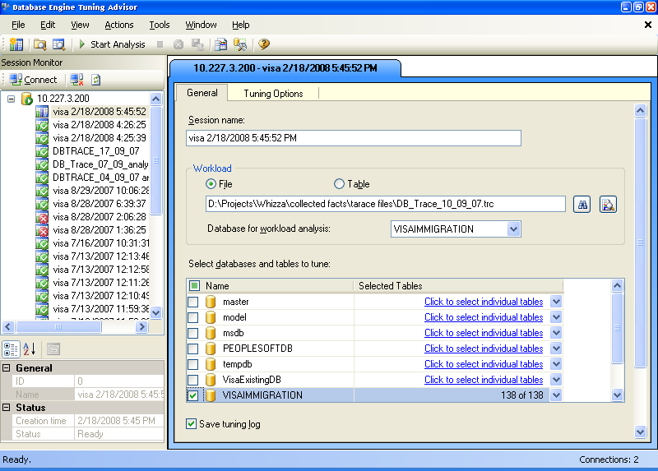
Database Engine Tuning Advisor
Select the trace file as workload file in Database Tuning Advisor and the database that you want the tuning advisor to give recommendations on.

Slide 22
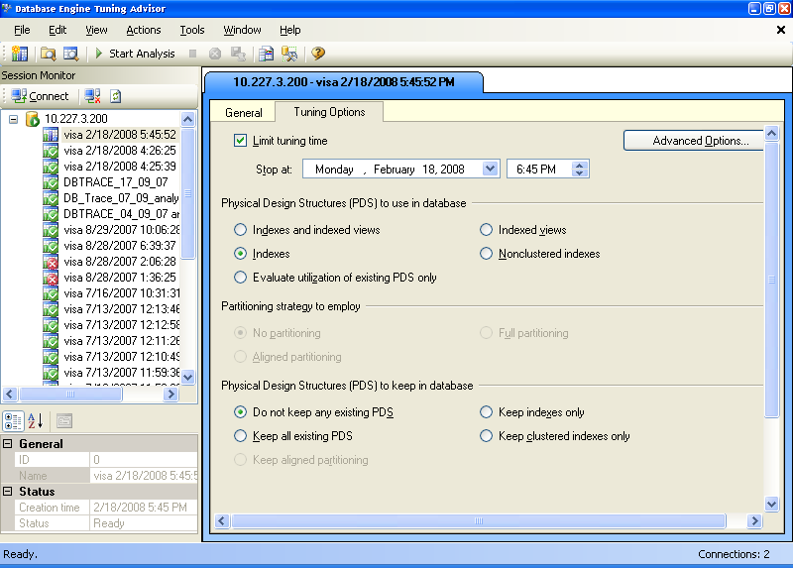
Database Engine Tuning Advisor
Set the tuning options for the tuning advisor as shown below, and start the analysis.

Slide 23
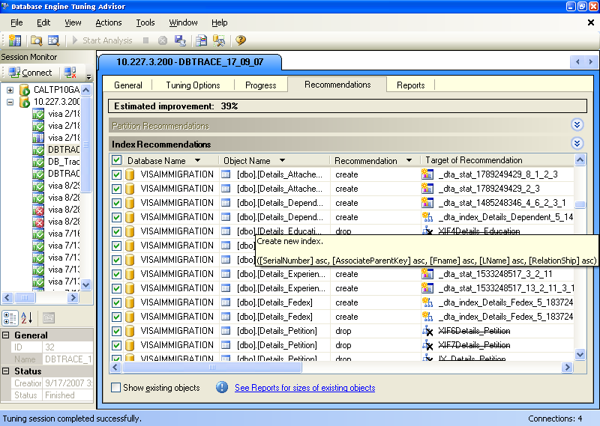
Database Engine Tuning Advisor
The Database tuning Advisor gives the recommendations as follows:-

Slide 24
Database Engine Tuning Advisor
DTA recommendations can be implemented manually or automatically as part of the tuning session.
Running DTA using GUI provides the flexibility to view the recommendations before implementation. Using dta command line utility with –a option causes the recommendations to be automatically implemented.
e.g. dta –S MyServer –E -D tpcd1G -if tpcd_22.sql -F –of script.sql –A 0 -m 5 -fa IDX_IV -s SessionName -a
When the GUI is used, changes can be applied by selecting Apply Now or Schedule For Later options in the Apply Recommendations dialog box.

Slide 25
Replay a Trace File
Saving your traces to a table enables one of the other exciting features of SQL Profiler: replaying traces
How to replay a trace file:
Select File, Open, Trace Table and choose a server to connect to that has a saved trace table. Open the trace table. Now you'll find that the commands on the Replay menu are active. Choose Replay, Start and SQL Profiler will let you choose a server to be the target of the replayed activity.
Why would you want to replay a trace?
Suppose you're debugging a problem with one of your servers - say, clients are deadlocking when running a particular set of queries. You can run SQL Profiler to capture a trace of the client activity that includes the deadlocks, and then rework the stored procedures on the server that you think are causing the deadlock. Replay the stored trace, and you can see whether your fixes were effective in preventing the problem from happening again.

Slide 26
Replay a Trace File (contd…)
To replay a trace, SQL Server must have certain event classes and data columns in the trace. The easiest way to make sure you have the minimum set in your trace is to start with the SQLProfilerTSQL_Replay trace template, which is one of the ones that's installed with SQL Server.
Using Breakpoints:
When you're replaying traces, you can use some standard debugging tools to view selected events in slow motion. Place the cursor on any line in the trace and then click F9 to set a breakpoint (or click F9 a second time to clear an existing breakpoint). Then you can click F5 to run the trace to the next breakpoint. At that point you can use the F10 key to execute the trace one statement at a time. Alternatively, you can use Ctrl+F10 to execute all statements up to the current cursor location.

Slide 27

Time for a Break !

Slide 28
SQL Trace
Profiler on a production environment is not a recommended practice, as it could degrade the performance of the server. Instead it is suggested doing server side tracing via SQL Trace system stored procedures.
SQL Server’s Server side tracing is used to Identify and solve potential bottle necks in SQL Server
Two jobs were created to start and stop the SQL Server Tracing on the Server
It is customized according to our needs
No need to have Sys Admin privileges for the person who runs the job (If we want to run the trace in Interactive mode we need to have sa rights)
The output of the trace will be automatically saved as .trc file mentioned in the path
SQL Trace system stored procedures used for Server Side Tracing

Slide 29
SQL Trace
We can identify the following Bottlenecks from Server side Trace:
Identifying long running stored procedures
Frequently growing database files
Locking Issues in Queries
Sort Warnings
Use Index Tuning Wizard to analyze the output for recommended Indexes
Tracing for specific errors
Troubleshooting deadlocks
Identifying stored procedure recompilations

Slide 30
SQL Trace
SQL Trace system stored procedures used for Server Side Tracing
sp_trace_create | Creates a trace definition
sp_trace_generateevent | Creates a user-defined event
sp_trace_setevent | Adds or removes an event or event column to a trace
sp_trace_setfilter | Applies a filter to a trace
sp_trace_setstatus | Used to start, stop and close traces

Slide 31
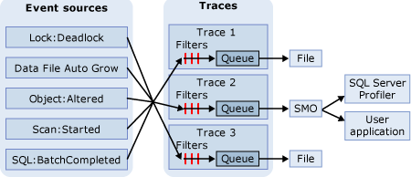
SQL Trace
The Event Sources can be any source that produces the trace event, such as Transact-SQL batches or SQL Server events, such as deadlocks. After an event occurs, if the event class has been included in a trace definition, the event information is gathered by the trace. If filters have been defined for the event class in the trace definition, the filters are applied and the trace event information is passed to a queue. From the queue, the trace information is either written to a file or can be used in SQL Server Profiler.

Slide 32
SQL Trace
Setting up of Trace
Log in as Local Administrator
Create a folder in c:\sqltrace. Share the folder and give write access to local users
Copy the tracedef.sql to the folder c:\sqltrace\
Open Start_trace.SQL
Change the Server parameter in the line ‘xp_cmdshell….’ to the SQL Server you
are going to install
Execute the SQL (Ignore any warnings)
Open Stop_trace.SQL
Execute the SQL (Ignore any warnings)
Two jobs, Start_trace and Stop_trace will be created.

Slide 33
Case Study – SQL Trace
/************************** Partial extract from the Trace Definition File *********************/
  -- Create a Queue
  declare @rc int
  declare @TraceID int
  declare @maxfilesize bigint
  set @maxfilesize = 5
  exec @rc = sp_trace_create @TraceID output, 2, N'C:\SQLTrace\sqlTrace', @maxfilesize, NULL
  if (@rc != 0) goto error
  declare @on bit
  set @on = 1
  -- Set the events
  exec sp_trace_setevent @TraceID, 10, 1, @on
  exec sp_trace_setevent @TraceID, 12, 11, @on
  exec sp_trace_setevent @TraceID, 12, 12, @on
  -- Set the Filters
  declare @intfilter int
  declare @bigintfilter bigint
  set @intfilter = 5
  exec sp_trace_setfilter @TraceID, 3, 1, 0, @intfilter
  exec sp_trace_setfilter @TraceID, 10, 0, 7, N'SQL Profiler'
  -- Set the trace status to start
  exec sp_trace_setstatus @TraceID, 1
/************************************************************************/

Slide 34
Case Study – SQL Trace
/********************************* Partial extract from Start Job Script*****************************/
EXECUTE @ReturnCode = msdb.dbo.sp_add_jobstep @job_id = @JobID, @step_id = 1, @step_name = N'Define trace', @command = N'--tidy up possible failed trace profiles
exec sp_trace_setstatus 1,2
exec sp_trace_setstatus 2,2
exec sp_trace_setstatus 3,2
--Delete old trace files
exec xp_cmdshell ''del G:\SQLTrace\*.trc''
--Define trace
exec xp_cmdshell ''isqlw.exe -SMSHFMMNSUKP0141 -dmaster -E -i"G:\SQLTrace\dwETLTraceDef.sql" -o"C:\SQLTrace\SQLTrace_output.txt"''', @database_name = N'master', @server = N'', @database_user_name = N'', @subsystem = N'TSQL', @cmdexec_success_code = 0, @flags = 0, @retry_attempts = 0, @retry_interval = 1, @output_file_name = N'', @on_success_step_id = 2, @on_success_action = 4, @on_fail_step_id = 0, @on_fail_action = 2
IF (@@ERROR <> 0 OR @ReturnCode <> 0) GOTO QuitWithRollback
/*********************************************************************************************************/

Slide 35
Case Study – SQL Trace
/********************************* Extract from the Stop Job Script ************************/
-- Add the job steps
EXECUTE @ReturnCode = msdb.dbo.sp_add_jobstep @job_id = @JobID, @step_id = 1, @step_name = N'Stop Trace', @command = N'exec sp_trace_setstatus 1, 0
exec sp_trace_setstatus 2, 0
exec sp_trace_setstatus 3, 0', @database_name = N'master', @server = N'', @database_user_name = N'', @subsystem = N'TSQL', @cmdexec_success_code = 0, @flags = 0, @retry_attempts = 0, @retry_interval = 1, @output_file_name = N'', @on_success_step_id = 2, @on_success_action = 4, @on_fail_step_id = 0, @on_fail_action = 2
IF (@@ERROR <> 0 OR @ReturnCode <> 0) GOTO QuitWithRollback
EXECUTE @ReturnCode = msdb.dbo.sp_add_jobstep @job_id = @JobID, @step_id = 2, @step_name = N'Finish Trace', @command = N'exec sp_trace_setstatus 1,2
exec sp_trace_setstatus 2,2
exec sp_trace_setstatus 3,2
', @database_name = N'master', @server = N'', @database_user_name = N'', @subsystem = N'TSQL', @cmdexec_success_code = 0, @flags = 0, @retry_attempts = 0, @retry_interval = 1, @output_file_name = N'', @on_success_step_id = 0, @on_success_action = 1, @on_fail_step_id = 0, @on_fail_action = 2
IF (@@ERROR <> 0 OR @ReturnCode <> 0) GOTO QuitWithRollback
/**********************************************************************************************************/

Slide 36
Case Study – SQL Trace
The Server side trace will create xxxxx.trc file.
This file should be used in Index Tuning Wizard for recommendations.
The output of the Server Side trace was used in Index Tuning Wizard. Index Tuning
Wizard recommended the following Indexes and Statistics:
/************************ Partial Output from Index TUNING Wizard *********************/
DROP INDEX [dbo].[BITempProductStoreSellingPrice].[BITempProductStoreSellingPrice_IX]
DROP INDEX [dbo].[BITempProductStoreVAT].[BITempProductStoreVAT_IX]
CREATE NONCLUSTERED INDEX [BITempProductStoreSellingPrice1] ON [dbo].[BITempProductStoreSellingPrice] ([ProductID] ASC, [StoreID] ASC, [StartDateID] ASC, [EndDateID] ASC )
/* Statistics to support recommendations */
CREATE STATISTICS [hind_SP] ON [dbo].[bitempproductstorevat] ([productid], [storeid], [startdateid], [enddateid], [vatpercentage], [vatablepercentage])
/***************************************************************************************/

Slide 37
SQL Profiler: Summary
Monitoring performance of the stored procedures and ad-hoc request running in production databases can help you in early identification of the possible system overload problems.
Usually, analyzing simple counters like procedure duration and number of reads performed by database engine is enough to identify procedures or queries that create unnecessary overload for the system. Usually this is happening due to a number of reasons such as logical errors in the code, poor database design, incorrect indexing strategy, etc.

Slide 38

Test Your Understanding
What is the recommended way of running the SQL Profiler. Why should we avoid running the profiler on the SQL Server itself which we are testing ?
What is an event and event category ?
What is a trace file ?
What are the important events that you should capture ?
How can you create a trace template ?
How is DTA useful ?
What is SQL trace ?

Slide 39
Questions from participants

Slide 40
SQL Server 2005 Tracing & Profiling: Source
SQL Server Developer Center
Inside Microsoft SQL Server
www.sql-server-performance.com
Disclaimer: Parts of the content of this course is based on the materials available from the Web sites and books listed above. The materials that can be accessed from linked sites are not maintained by Cognizant Academy and we are not responsible for the contents thereof. All trademarks, service marks, and trade names in this course are the marks of the respective owner(s).

Slide 41
You have successfully completed
SQL Server 2005 Tracing & Profiling
Click here to proceed

